Slide 1




“ งานใหม่ใกล้ฉัน ” New jobs near me
ICS-Dept.
10 Apr. 25
1
Auto application access

Slide 2









ICS-Dept.
10 Apr. 25
2
Agenda
Organization
01
Action plan
05
Activity Brainstorming
02
Activity Operation
06
Motivation of Activity
03
Result Activity
07
Objective and Target (Goal)
04
Next Action
08
Notes:
การนำเสนอในครั้งนี้จะเริ่มจาก Organization ไปจนถึง Result และ Next Action ค่ะ

Slide 3


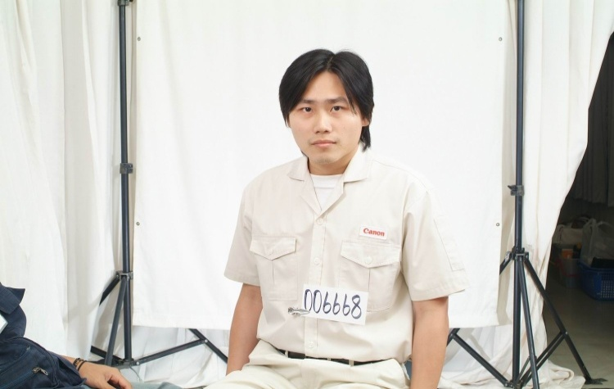
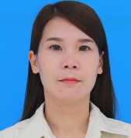
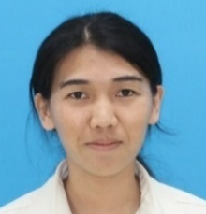
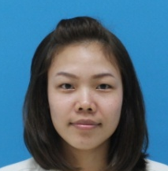
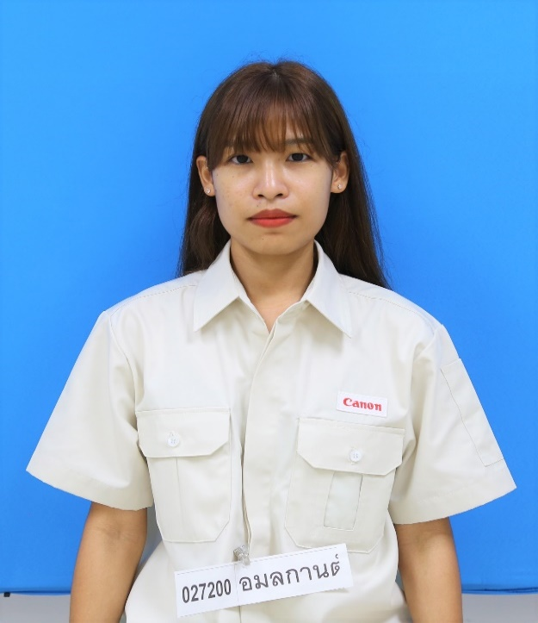
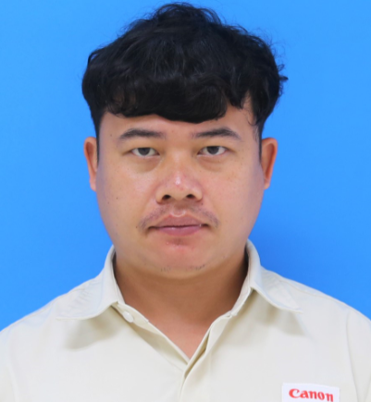
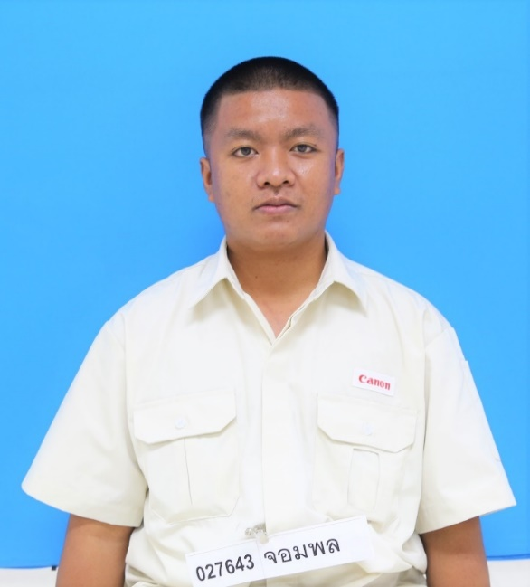

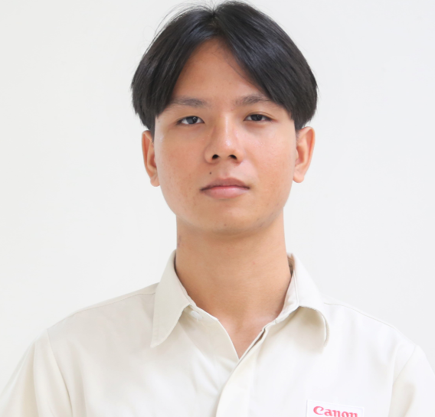

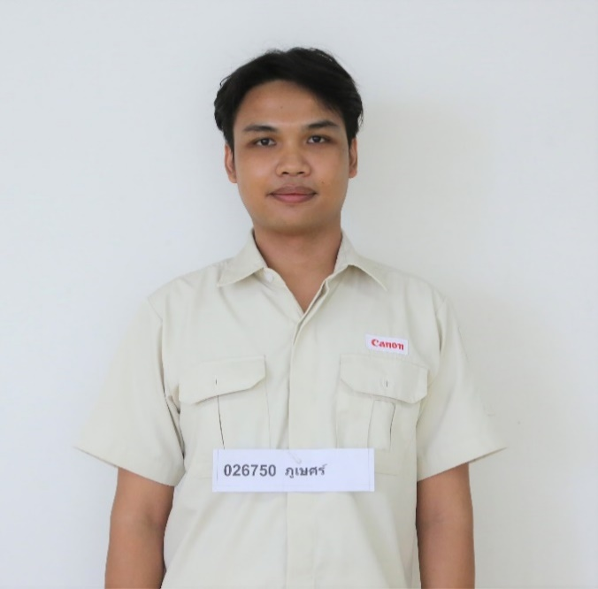
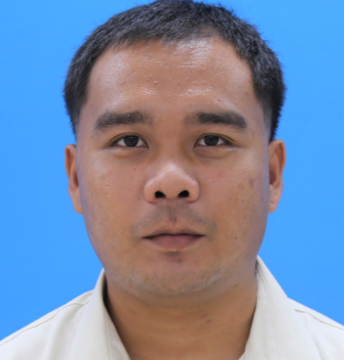
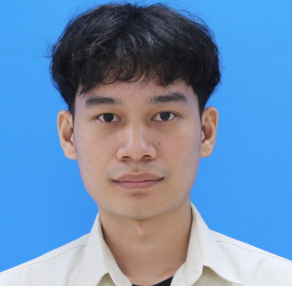
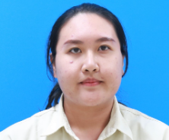


ICS-Dept.
10 Apr. 25
3
Organization
Advisor
Coach
Leader
Sub Leader
MR.SANCHAI
MS.NAREE
MS.ALISA
MS.SARUDA
MS. AMOLAKARN
MR. TEERAPON
MR.JOMPHON
MR. JAKKRIT
MR. CHANOKCHON
MR.PHUBET
MR.ATTAPON
MR. SATAWWAT
MS. NATTHANIT
MS. SASIKAN

Slide 4

ICS-Dept.
10 Apr. 25
4
Activity Brainstorming
No. | Topic | Good Point | Weak Point | Status
1. | Improvement reservation room (C,D,M) | 1. Reduce workload ICS member to modify room.(Add, Update, Delete) 2. User can manage by self for Easy & short time to period | 1. ICS has workload to Develop program more than merit Reduce workload. 2. The frequency of user requests is low (2024 :10 request)
2. | Test system by Robot (Q,C) | 1.Reduce workload ICS member to test system. | 1.The system is frequently modified, need to modify Robot to accommodate
3. | 5S Folder (Q,C,M) | 1.Increase space on file server 2.Easy & short time to access document | 1. Consider difficult file management access 2. There is a chance of error and data loss.
4. | “Auto application access” (C,D,S) | 1.Reduce workload ICS member for register user to system. 2.Reduce mistake of operation register 3.Data security | 1.Not all system can auto register.

Slide 5
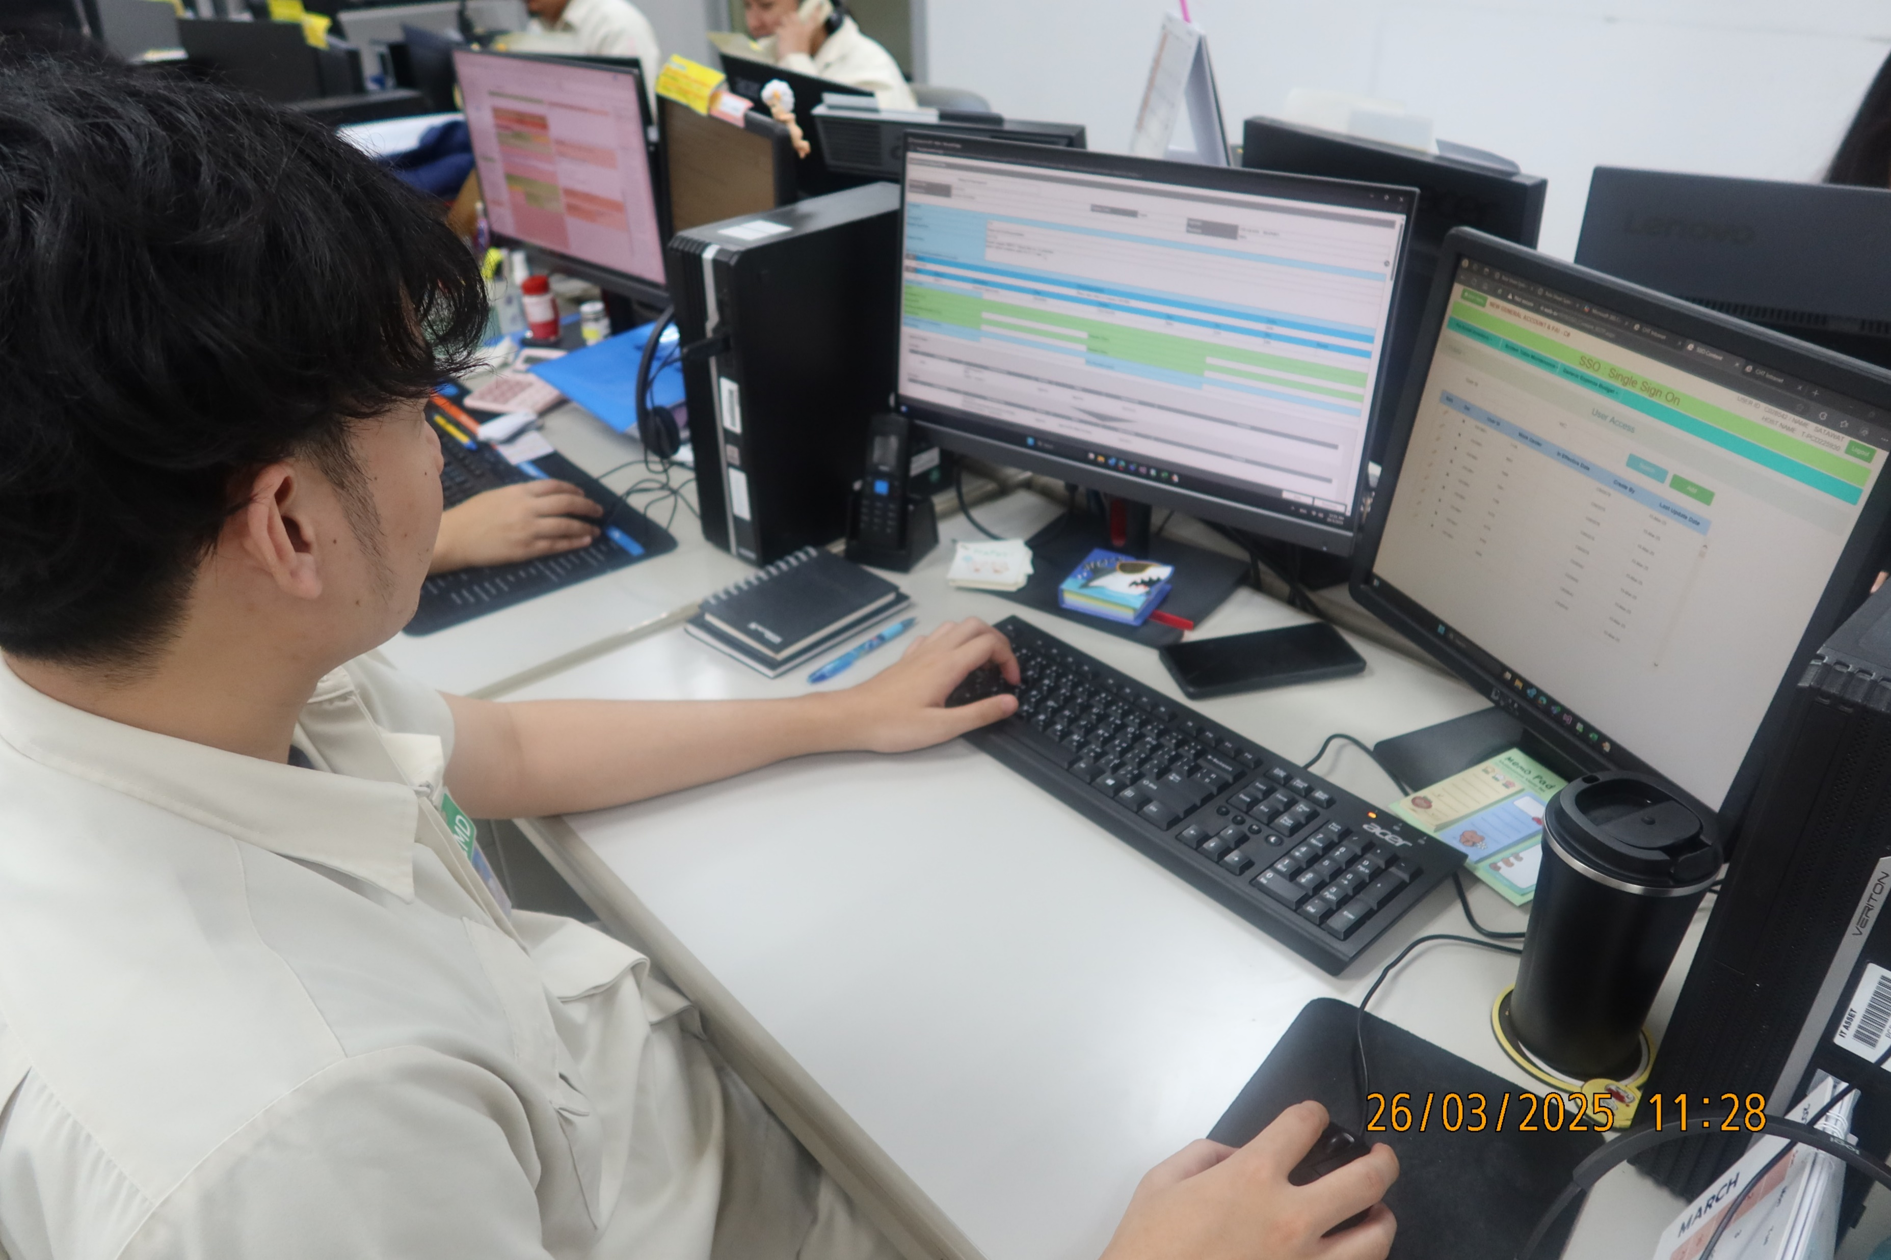
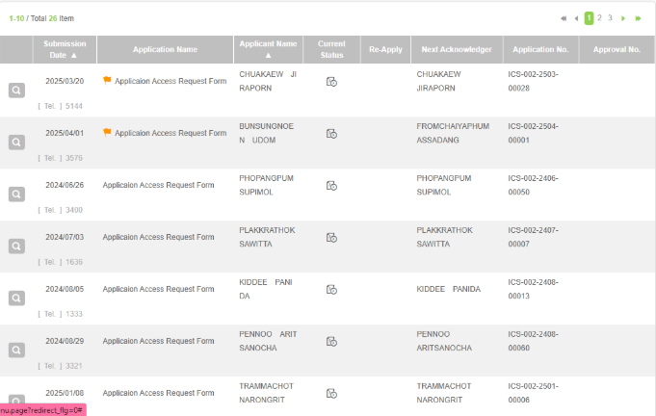
Motivation of Activity
ICS-Dept.
10 Apr. 25
5
The system in CHT has a large volume, and ICS must control access rights for all systems. Therefore, there are most requests that need to be handled daily, which is a daily job that must be done every day.
Therefore, the group has the idea to change it to an automated format to reduce the workload in operations

Slide 6




Motivation of Activity
ICS-Dept.
10 Apr. 25
6
BEFORE
AFTER
USER
USER
User issue FlowLites
User issue FlowLites
ICS
PROGRAM
ICS
1.ICS Check user already exists and approve
2 min / user
1.ICS Check user already exists and approve
1 min / user
ICS
PROGRAM
ICS
2.ICS Register menu SSO
2.ICS Register menu SSO
1 min / user
2 min / user
ICS
PROGRAM
ICS
3.ICS Register role system
and approve
3 min / user
3.ICS Register role system
and approve
1.5 min / user
USER
USER
Can use system
Can use system
TOTAL WORKLOAD : 7 Min / user
TOTAL WORKLOAD : 3.5 Min / user

Slide 7



ICS-Dept.
10 Apr. 25
7
Objective and Target
3 min
TOTAL application in 2024 : 1,313 user
Workload : 9,191 Min (153 Hr.)
2 min
2 min
1.5 min
Estimate workload 2025 : 1,313 user
Workload : 4,595 Min (76 Hr.)
1 min
1 min
Objective :
Reduce workload in operation register user.
Target :
Reduce workload 50%
3.5 MIN /Application

